Slide 1

Mini Project-I (K24MCA18P) Odd Semester Session 2024-25
WORKPLACE – SAFETY WEBSITE
Aashi Sharma :2426MCA203
Akansha Tomar :2426MCA1870

Slide 2
Content
Introduction (1 slide)
Literature Review (2 slides)
Objective of the Project (1 slide)
Technology
Hardware Requirements (Development Environment, Server requirement (if required), Client requirement (if required).
Software Requirements
Modules (2 slides)
Workflow (1 slide)
Reports
References (1 slide)
Notes:
Font Styles: Times New Roman + Font Size: 25

Slide 3
Introduction
We Prioritize The Health And Safety Of All Employees, Contractors, And Visitors. Our Mission Is To Foster A Culture Where Safety Is An Integral Part Of Our Operations, Ensuring A Secure And Productive Working Environment. This Website Serves As A Comprehensive Resource To Guide You Through Essential Safety Practices, Regulatory Compliance, And Emergency Preparedness.
By Offering Clear Guidelines, Training Materials, And The Latest Industry Updates, We Aim To Equip Everyone With The Knowledge And Tools Necessary To Prevent Accidents, Reduce Risks, And Promote Overall Well-being At The Workplace. Your Safety Is Our Commitment.
Stay Informed, Stay Safe, And Work Smart!
Notes:
Font Styles: Times New Roman + Font Size: 25

Slide 4
Literature Review
Literature Review: Best Practices for Workplace Safety Websites
Workplace safety is a critical concern for organizations across industries, and developing a website dedicated to safety can play a key role in promoting a culture of health and well-being. In recent years, researchers and safety professionals have explored the effectiveness of digital platforms in delivering safety information, providing training, and facilitating communication on safety matters. This review focuses on key themes that have emerged in the literature on the design and impact of workplace safety websites.
1. Digital Platforms as Tools for Safety Communication
Studies show that safety websites are most effective when they function as dynamic communication platforms (Bhandari, 2019). Effective sites provide real-time updates on policies, incident reporting mechanisms, and personalized safety resources. Liu and Zhang (2020) argue that integrating interactive features such as chatbots, safety forums, and live training sessions increases user engagement and ensures the timely delivery of critical safety messages.
2. Content Design and User Experience
The literature emphasizes that clear, concise, and accessible content is essential for an effective workplace safety website. According to Nielsen (2018), content should be tailored to different employee roles and levels of expertise. Visual elements such as infographics, video tutorials, and step-by-step guides significantly enhance comprehension (Green & McIntyre, 2017). Accessibility for employees with disabilities is also a critical consideration, as discussed by Jones et al. (2021), who highlight the need for compliance with web accessibility standards.
Notes:
Font Styles: Times New Roman + Font Size: 25

Slide 5
Literature Review (Contd.)
3. Mobile Accessibility and Responsive Design
As more organizations adopt flexible work environments, mobile accessibility has become increasingly important for safety platforms. Several studies advocate for responsive design to ensure the safety website can be accessed from any device, including smartphones and tablets (Smith & Clark, 2020). This allows workers in remote or field-based roles to access safety resources and report incidents efficiently, regardless of their location (Miller & Thompson, 2021).
4. E-Learning and Training Integration
Integrating e-learning modules into workplace safety websites has been identified as a best practice for continuous safety education (Brown et al., 2019). Research shows that digital safety training, combined with interactive elements like quizzes and simulations, improves knowledge retention and application in real-world scenarios (Johnson & Lee, 2020). Websites with learning management system (LMS) integration have the added advantage of tracking employee progress and ensuring compliance with mandatory safety training (Williams & Harris, 2021).
Notes:
Font Styles: Times New Roman + Font Size: 25

Slide 6
Objective of the Project
The objective of a workplace safety website project can be outlined as follows:
Enhance Safety Awareness: To provide employees with easy access to safety guidelines, policies, and procedures, ensuring they are aware of potential workplace hazards and the steps needed to avoid them.
Promote Compliance: To ensure the organization complies with local, national, and industry-specific safety regulations by offering clear, up-to-date information on safety standards and legal requirements.
Facilitate Training and Education: To offer comprehensive safety training and educational resources, including e-learning modules, video tutorials, and interactive materials, enabling employees to stay informed and competent in safety practices.
Streamline Incident Reporting: To create an efficient and user-friendly platform for employees to report accidents, near misses, and unsafe conditions, promoting transparency and timely corrective actions.
Support a Safety Culture: To foster a proactive safety culture where employees actively participate in maintaining a safe working environment through continuous learning, reporting, and improvement of safety practices.
Improve Communication: To provide a central platform for real-time communication regarding safety updates, emergency procedures, and any changes to safety policies, ensuring that all employees are kept informed.
Ensure Accessibility: To offer a website that is accessible from various devices (including mobile) and adheres to web accessibility standards, ensuring all employees, regardless of their physical abilities or location, can engage with the platform.
Notes:
Font Styles: Times New Roman + Font Size: 25

Slide 7
Technology (Hardware Requirements)
Requirements:
Processor: Multi-core (Xeon or equivalent)
RAM: 16 GB or higher
Storage: SSD (500 GB – 1 TB or more based on expected data volume)
Network Interface Card (NIC): High-speed (1 Gbps or higher)
Redundant Power Supply (for reliability)
Notes:
Font Styles: Times New Roman + Font Size: 25

Slide 8
Technology (Software Requirements)
Purpose: To create the front-end (user interface) and back-end (server-side) functionalities of the website.
Frontend Development:
HTML, CSS, and JavaScript: For creating responsive web pages//BOOTSTRAP
Backend Development:
REACT.JS
Notes:
Font Styles: Times New Roman + Font Size: 25

Slide 9
Modules
Home Page-Overview of the website
Navigation to other modules
Safety Training
Training courses -Certification programs
Progress tracking
Incident Reporting
Form submission for incidents
Safety Resources
Notes:
Font Styles: Times New Roman + Font Size: 25

Slide 10
Modules (Contd.)
Company safety policies-Compliance information
Updates on regulations
User Accounts
Registration-Profile management
Access controls based on roles
Feedback and Suggestions
Form for user feedback-Reviews of safety protocols
Contact Us
Contact form
Notes:
Font Styles: Times New Roman + Font Size: 25

Slide 11
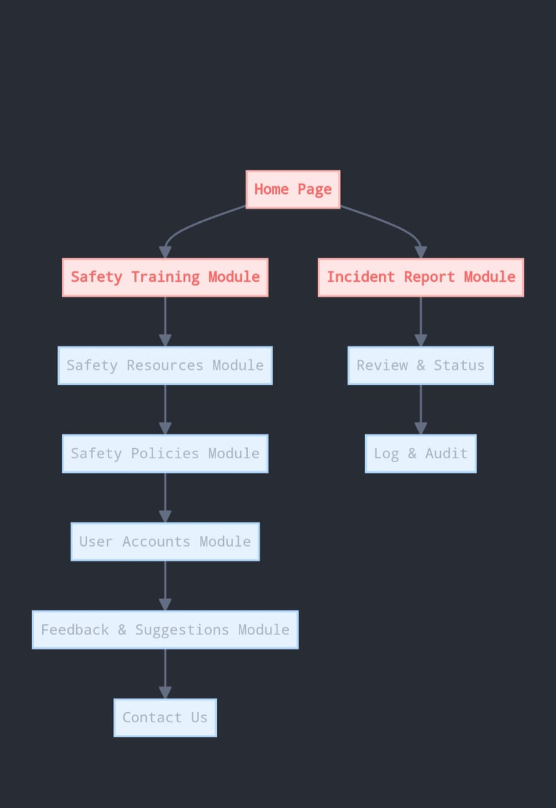
Workflow/Gantt Chart
Notes:
Font Styles: Times New Roman + Font Size: 25

Slide 12
Reports
Reporting Period: January 2023 - December 2023
Total Incidents
Total Reported Incidents: 250
Breakdown of Incident Types
Slips, Trips, and Falls: 110 incidents (44%)
Electrical Accidents: 50 incidents (20%)
Fires and Explosions: 15 incidents (6%)
Overexertion-related Incidents: 60 incidents (24%)
Struck by Objects: 15 incidents (6%)
Notes:
Font Styles: Times New Roman + Font Size: 25

Slide 13
References
injuryfacts.nsc.org/work/work-overview/top-work-related-injury-causes/
https://www.bls.gov/iif/factsheets/
https://www.osha.gov/data/work
https://www.dol.gov/general/topic/statistics/safety
https://paperswithcode.com/dataset/incidents1m
Notes:
Font Styles: Times New Roman + Font Size: 25

